Slide 1


Machine learning for physics and astronomy chapter 4
Viviana Acquaviva

Slide 2
support vector machines (SVMs)

Slide 3
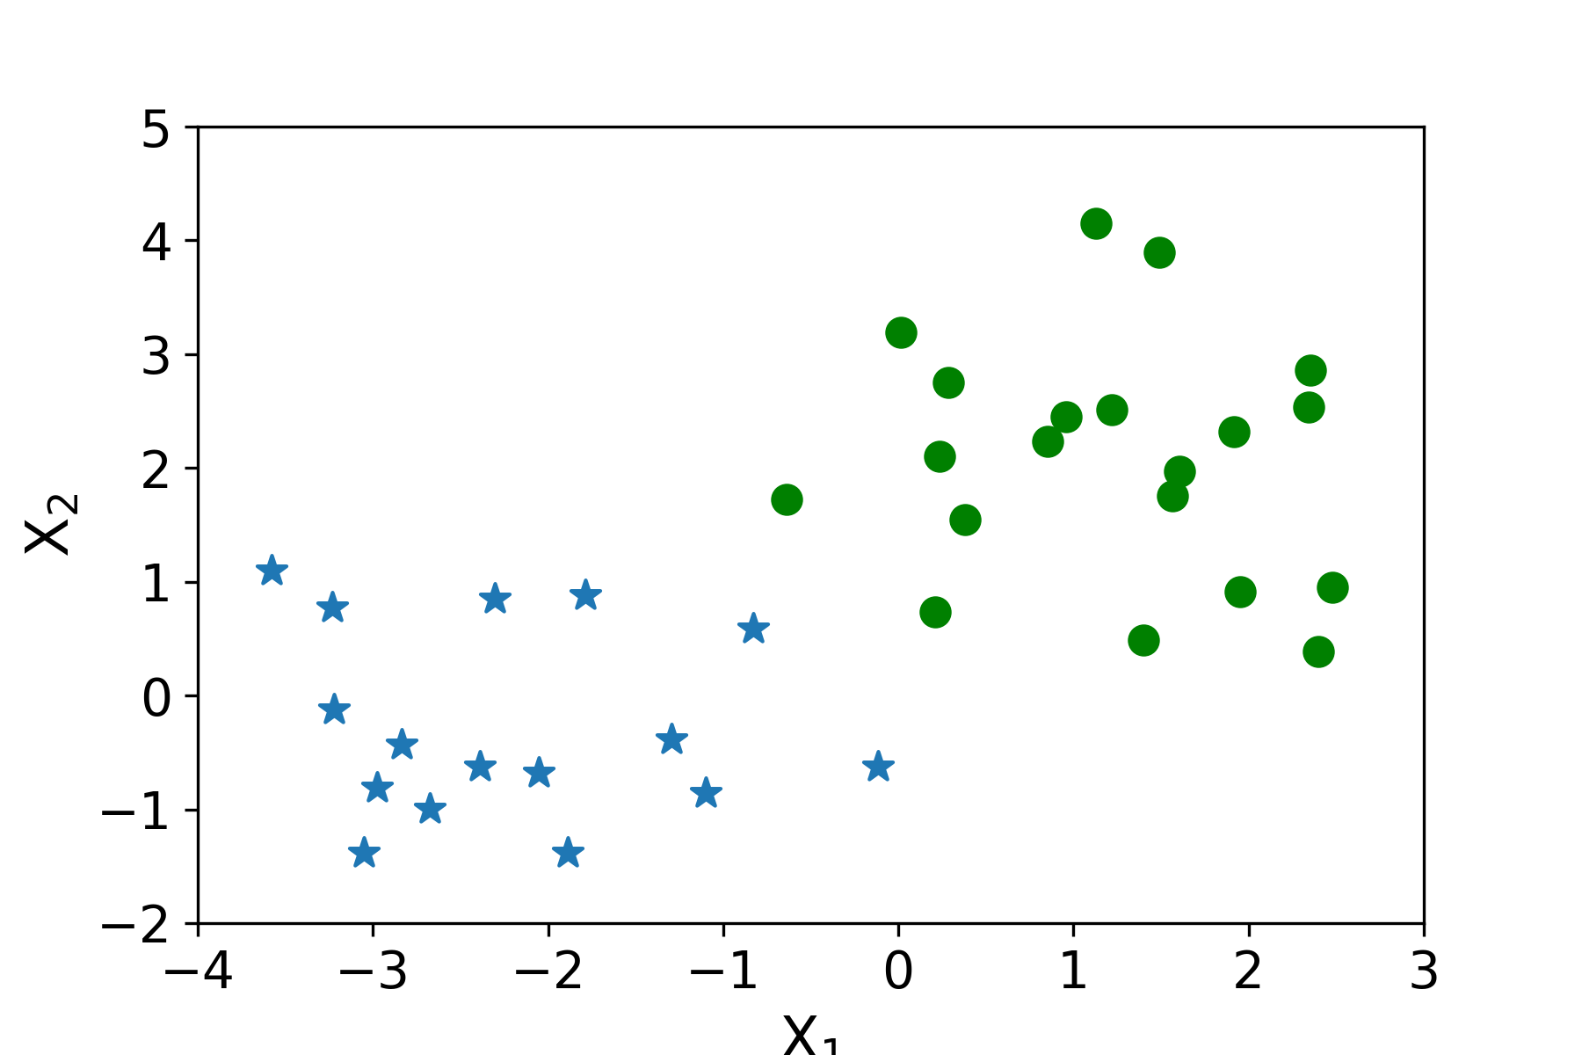
Support Vector Machines (SVM)
One of the most powerful classification/regression algorithms before “going neural”
In a nutshell: SVMs look for the best linear separator
(line or hyperplane) between two classes.
Notes:
It’s a generalization of the line from the previous plot, where we work in as many dimensions as we want, and we look for a wobbly hyperplane rather than use a line

Slide 4
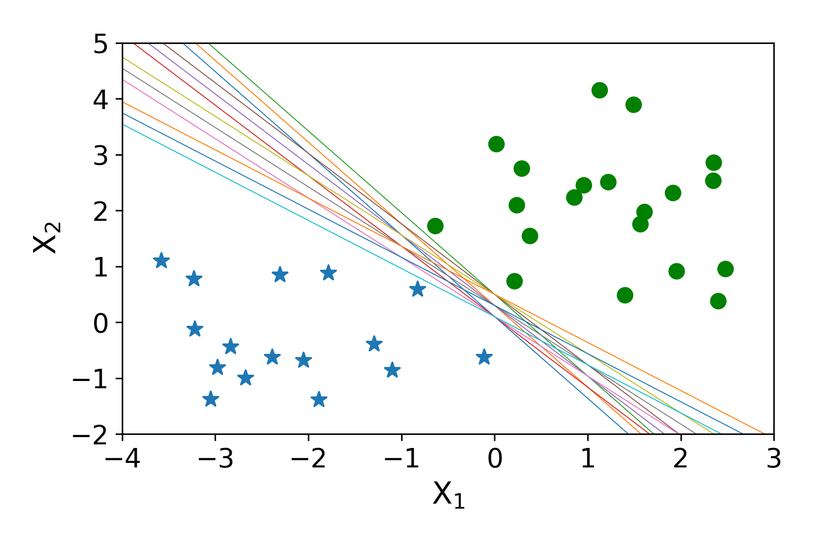
Linear SVMs
These objects can be separated in many ways using a hyperplane
(= a line in a 2D space). But which of the linear separators is optimal?

Slide 5
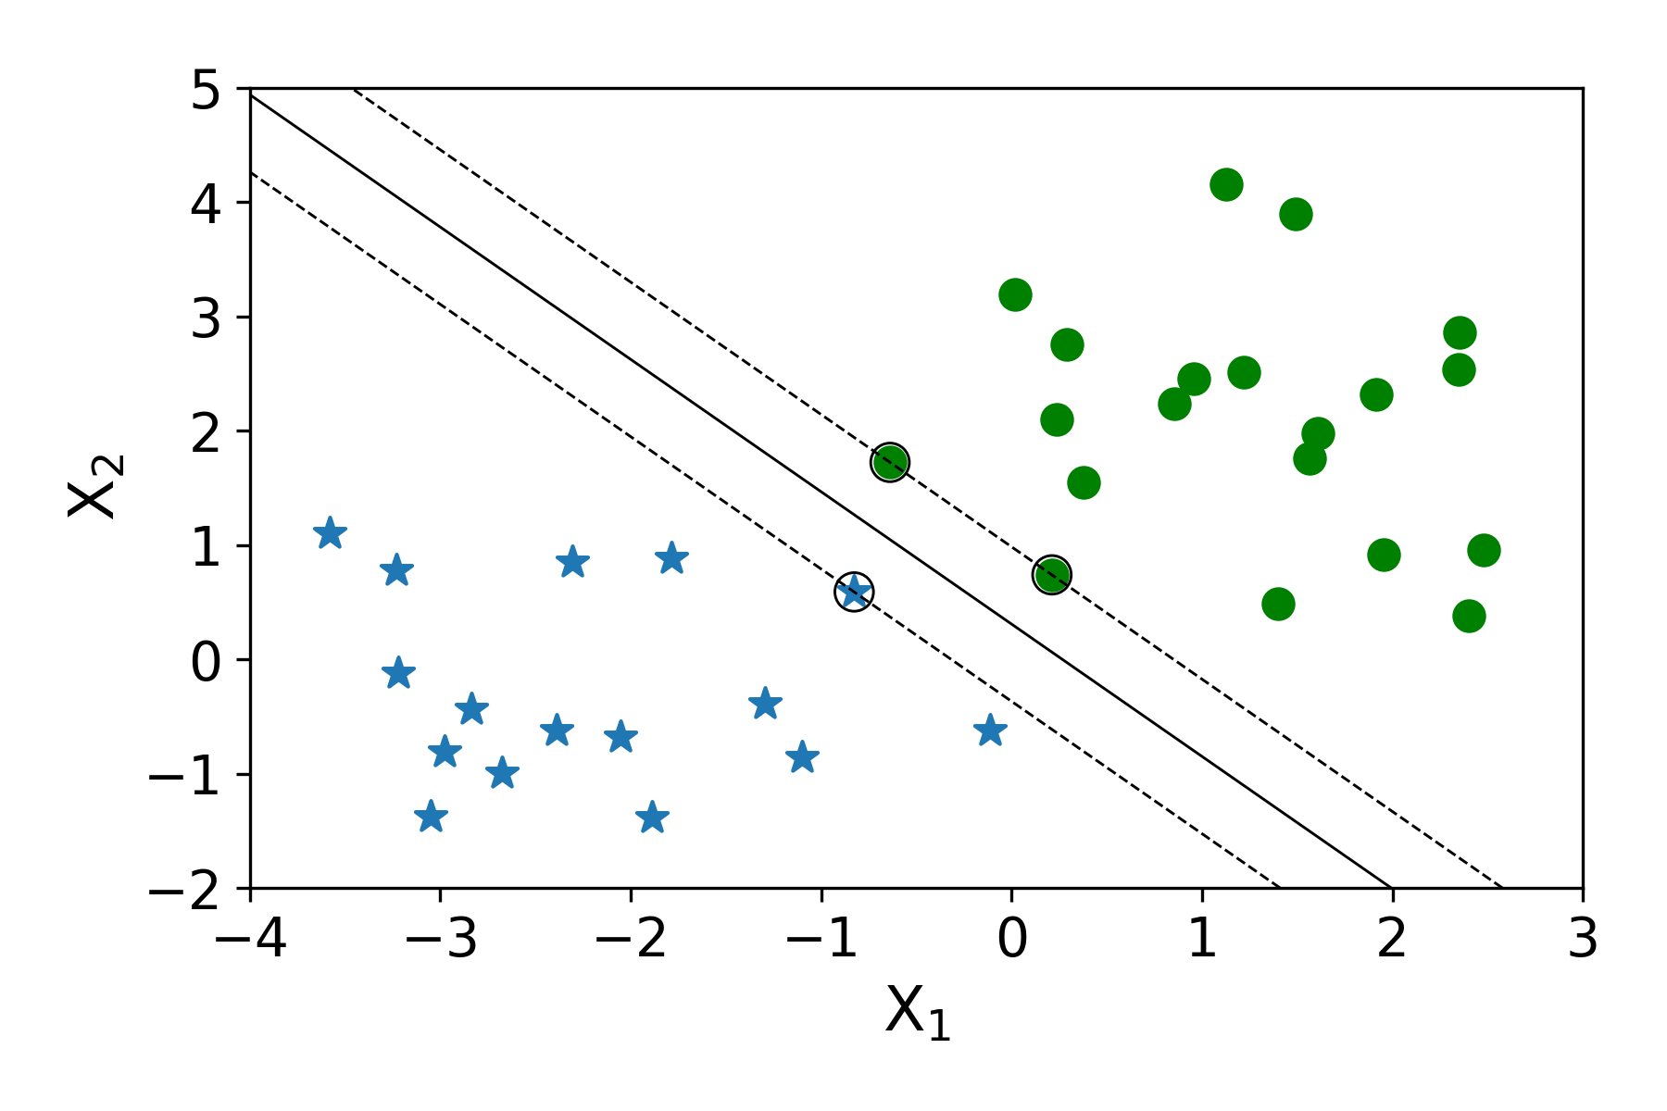
LINEAR SVMS – SEPARABLE CASE
LINEAR SVMS – SEPARABLE CASE
Idea 1. If the data are separable, find the decision boundary that maximizes the separation between the two classes
Examples closest to the
hyperplane (more precisely, the examples that affect the decision boundary) are
support vectors.
The distance between closest support vectors of opposite classes
is called margin.

Slide 6
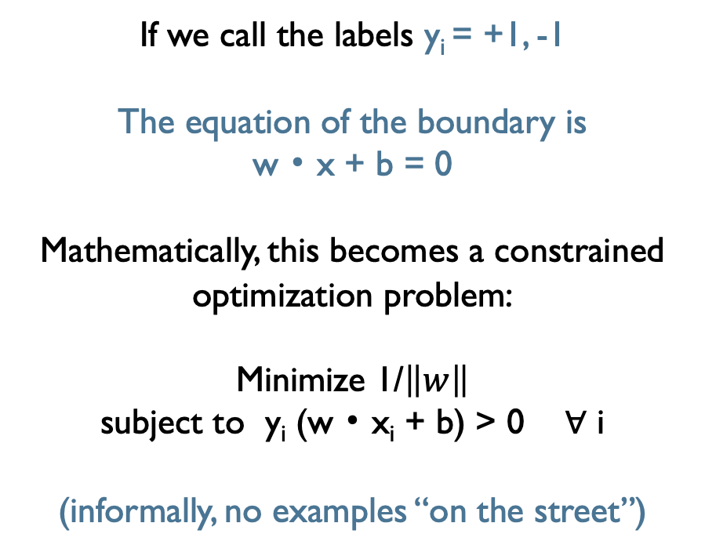
LINEAR SVMS – SEPARABLE CASE
Idea 1. If the data are separable, find the decision boundary that maximizes the separation between the two classes
If we call the labels y_{i} = +1, -1
The equation of the boundary is
w ･ x + b = 0
Mathematically, this becomes a constrained optimization problem:
Minimize 1/$\left\|w\right\|$
subject to y_{i} (w ･ x_{i} + b) > 0 ∀ i
(informally, no examples “on the street”)
Important: Using dual (Lagrangian) formulation,
you can show that to classify a new example,
you only need the dot products of the new example and the support vectors.

Slide 7
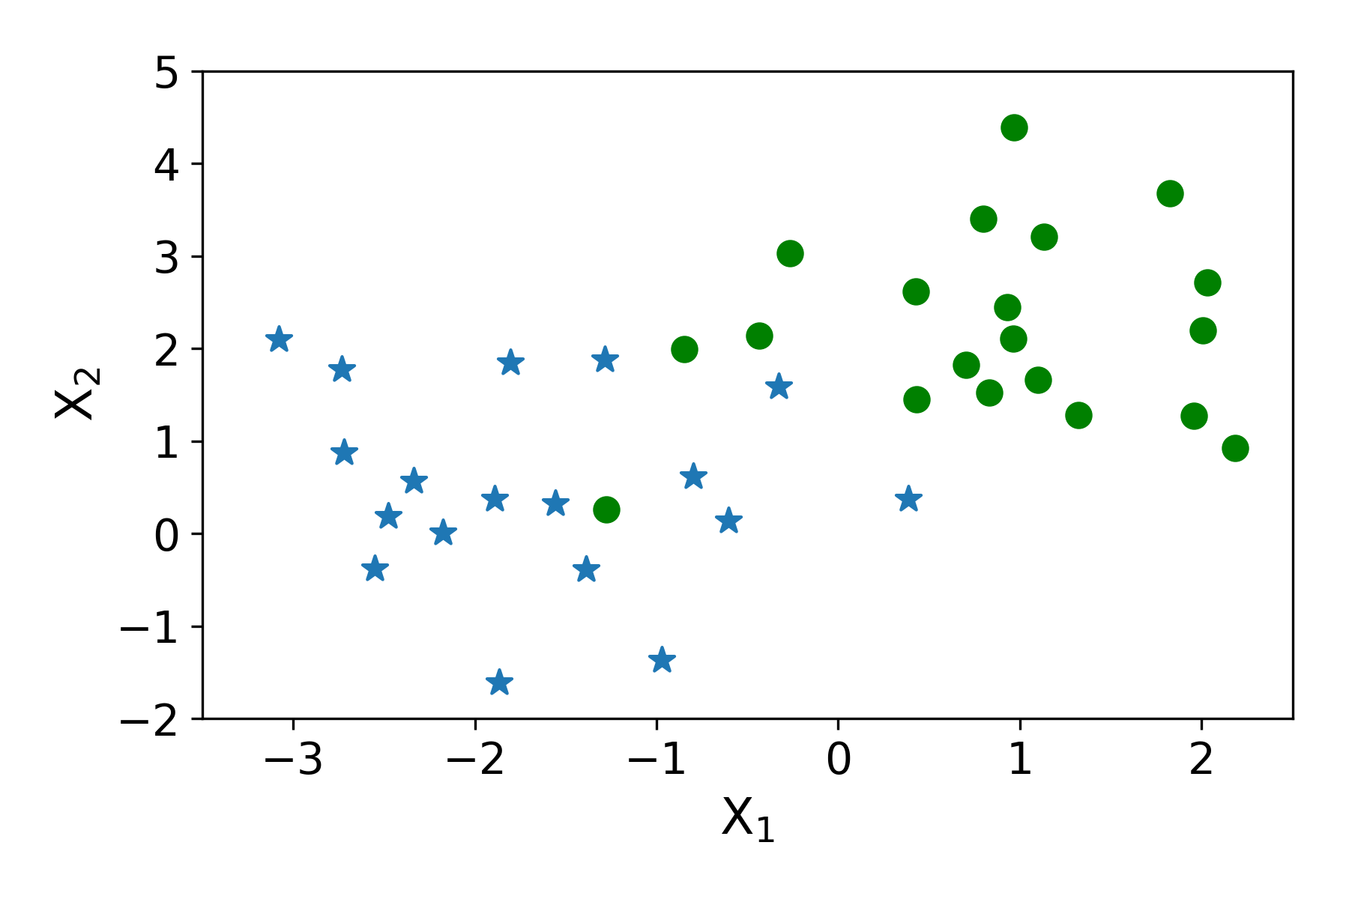
LINEAR SVMS SEPARABLE w/noise CASE
Idea 2. If the data are separable with some noise,
add slack variables that allow for misclassifications (regularization)

Slide 8
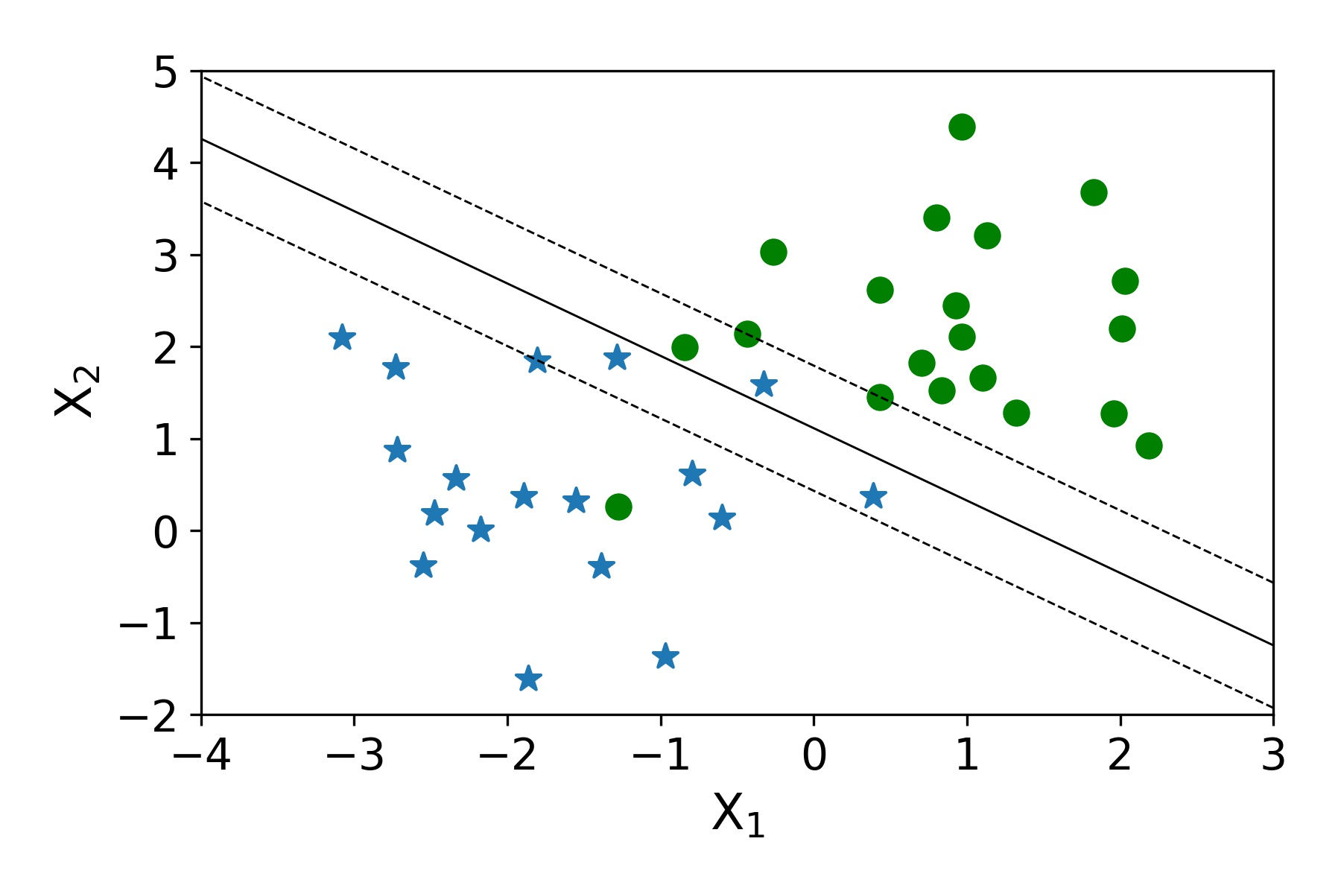
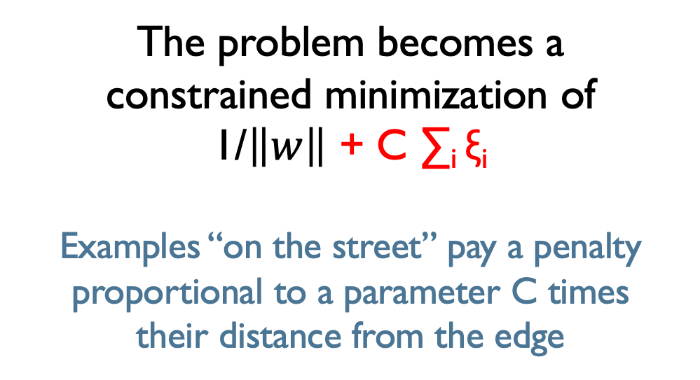
LINEAR SVMS SEPARABLE w/noise CASE
Idea 2. If the data are separable with some noise,
add slack variables that allow for misclassifications (regularization)
The problem becomes a
constrained minimization of
1/$\left\|w\right\|$ + C ∑_{i} ξ_{i}
Examples “on the street” pay a penalty proportional to a parameter C times
their distance from the edge
ξ₁
ξ₃
ξ₄
ξ₂
ξ₅

Slide 9
Non-linear SVMs
Datasets that are linearly separable, even with some noise, work out great.
But what are we going to do if the dataset cannot be separated with a line?
How about… mapping data to a higher-dimensional space?
0
x
x²
0
x

Slide 10
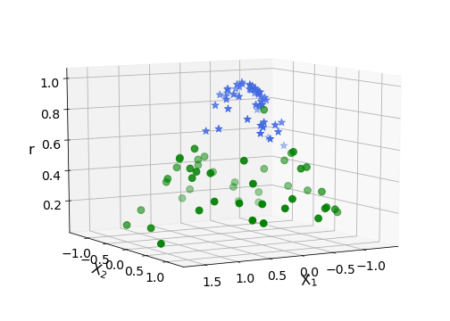
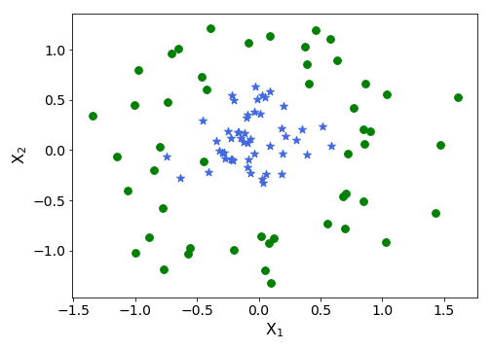
Non-linear SVMs: Feature spaces (kernel trick)
General idea: the original feature space can be mapped to some higher-dimensional feature space where the training set is separable:
x → φ(x)

Slide 11
Non-linear SVMs: Feature spaces (kernel trick)
This doesn’t sound or look too special because we already talked about
feature engineering. For example, from feature x we can calculate x², x³…
x → φ(x)
To work in your new feature space,
wherever you had dot products in original feature space, x^{T} z,
you should now use φ(x)^{T} φ(z).
Suppose that your mapping function is associated to a kernel K(x, z) = φ(x)^{T} φ(z).

Slide 12
THe Kernel trick
If such mapping exists, the decision function
in the new feature space only depends on K(x, x_{j}),
where x_{j} are the support vectors (in original feature space).
You never have to explicitly calculate the mapping function.
Additionally, calculating K(x, x_{j}) is O(n)!
Does this mapping exist?
Yes and no.
If you give me a mapping, I can’t give you a kernel.
But if you give me a positive semi-definite function
in the original feature space,
there exists a mapping associated with it.

Slide 13

THe Kernel trick
“Good” (semipositive-definite) kernel functions
can be associated to feature mappings.
(Mercer theorem)
For example, the polynomial kernel of degree d:
Corresponds to all polynomial combinations of original features up to degree d
and the Gaussian Kernel
corresponds to an infinite-dimensional feature mapping!
$γ$(sklearn) ⟺ 1/(2σ²)
IN OTHER WORDS, WE CHOOSE THE
KERNEL, NOT THE MAPPING,
AND WE TAKE ADVANTAGE OF
AN UPGRADED FEATURE SPACE WITHOUT EVER EXPLICITLY WORKING IN THAT SPACE.

Slide 14
The math of SVM is beautiful (this is a tiny summary of how I understand it)
Given boundary equation w x + b = 0:
Rescale w and b so that the edges of margin have equations w x + b = -1; w x + b = 1
For all correctly classified examples, y ・ (wx + b) > 0 and the decision function is g(w x + b) > 1 or g(w x + b) < -1, g is step function
Maximize 1/|| w ||₂ , subject to y ・ (wx + b) > 0 an all training data (This can be solved with Quadratic Programming)
To solve efficiently: turn this constrained maximization problem into a Lagrange multiplier formulation (primal/dual), allows one to write decision function as a function of inner product of example x with training examples x_{j}
Non separable case: add slack variables (for which g(w x + b) < -1 does not hold) and maximize 1/|| w ||₂ + C ∑i ξi
To solve: find new mapping x -> Φ(x) to higher dimensional space where instances are more separated
Kernel trick (Mercer theorem): if K is semipositive definite, inner product of Φ(x_{i}) Φ (x_{j}) is prop to K(xi, xj) and the complexity of this operation is O(n). Gives decision function in mapping space without explicit mapping.
But if you really want to see it, see Andrew Ng’s notes
http://cs229.stanford.edu/summer2020/cs229-notes3.pdf

Slide 15
Hyperparameters of SVMs
Regularization parameter, C

Slide 16
Hyperparameters of SVMs
Degree parameter for a polynomial kernel

Slide 17
Hyperparameters of SVMs
Gamma parameter for a Gaussian kernel

Slide 18
Hyperparameters of SVMs
Class weight (this is a cool one!)

Slide 19
Optimizing hyperparameters
Should we vary hyperparameters all together or one at a time?
All together is probably formally correct because if they are correlated, I can’t trust the results of varying one at a time; on the other hand, to build intuition and limit optimization time, one at a time may be useful
2) Do you see any problem with using the test scores cross validation to pick the hyperparameters?
It is ok to do this to pick optimal hyperparameters, but the test scores I obtain are still optimistic.

Slide 20
Application: particle identification IN LHC event simulations (looking for bsm physics)
All the possible proton - proton collision products…

Slide 21
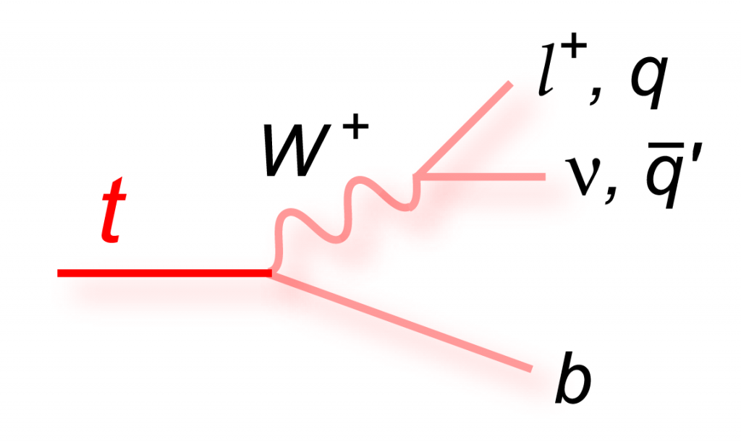
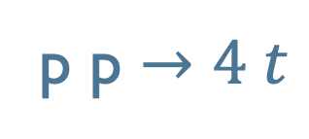
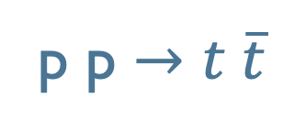
We focus on a subset with two channels 😅
p p $→t \overline{t}$
p p $→4 t$
Problem: the top quarks are not observed directly,
because they decay in a W boson and a bottom quark,
and the W boson decays in leptons/quarks (jets),
and neutrinos (unobserved).

Slide 22
Data set description
10, 000 events
For each event, we have the list of particles produced in the event + missing energy/momentum (carried by neutrinos)
For each particle, known features include the type
and the 4-momentum
The label is ttbar/ 4top

Slide 23
Optimizing hyperparameters and nested cross validation

Slide 24
Optimizing hyperparameters
The most common procedure to optimize hyperparameters is a cross-validated Grid Search of the hyperparameter space.
Like with any parameter space search, the grid method can be inefficient, or too time-consuming. Alternatives are varying parameters one at a time (ignores correlations), Random Search (often good enough), Bayesian parameter search (yay!).
As a reminder, we do this to pick optimal hyperparameters, but the test scores we obtain are still optimistic (there is leakage of information between the optimization and the test scores).
The correct procedure involves a 3-tiered structure: train/validation/test. If we do this in a cross-validated way, it becomes nested cross validation.

Slide 25
How can we optimize the hyperparameters?
LEARNING SET
USED TO
EVALUATE PERFORMANCE ON “NEW” DATA
This set
should know nothing
about parameter optimization!
TRAINING SET
USED TO FIND OPTIMAL HYPERPARAMETERS
AND TO TRAIN ALGORITHM
TEST SET

Slide 26
Nested cross validation is used to properly estimate generalization error (nested = two levels, outer/inner)
Outer 5 fold cross validation:
uses 80% for training, 20% for testing
and averages performance 5 times (nothing new so far)
OUTER
TEST
OUTER
TRAINING

Slide 27
Inner cross validation (inside gray outer training set) will be used to do the grid search; we will do this 5 times (or as many outer CV folds we have).
HYPERPARAMETER SEARCH
(INNER TEST, 20% of total)
HYPERPARAMETER SEARCH
(INNER TRAINING, 60% of total)
Here we show 4 fold inner cross validation on the outer training set.

Slide 28
Let’s see it with one parameter: C = {1, 10, 100}
1) Set C = 1
2) Do k fold inner cross validation on the outer training set (gray, 80% of total). Here we divide in 4 folds where 3 are used for inner training, 1 for inner testing.
3) Report average of performance.
HYPERPARAMETER SEARCH
(INNER TEST, 20% of total)
HYPERPARAMETER SEARCH
(INNER TRAINING, 60% of total)

Slide 29
Let’s see it with one parameter: C = {1, 10, 100}
1) Set C = 1
2) Do k fold inner cross validation on the outer training set (gray, 80% of total). Here we divide in 4 folds where 3 are used for inner training, 1 for inner testing.
3) Report average of performance.
HYPERPARAMETER SEARCH
(INNER TEST, 20% of total)
HYPERPARAMETER SEARCH
(INNER TRAINING, 60% of total)

Slide 30
Let’s see it with one parameter: C = {1, 10, 100}
1) Set C = 1
2) Do k fold inner cross validation on the outer training set (gray, 80% of total). Here we divide in 4 folds where 3 are used for inner training, 1 for inner testing.
3) Report average of performance.
HYPERPARAMETER SEARCH
(INNER TRAINING, 60% of total)
HYPERPARAMETER SEARCH
(INNER TEST, 20% of total)

Slide 31
Let’s see it with one parameter: C = {1, 10, 100}
1) Set C = 1
2) Do k fold inner cross validation on the outer training set (gray, 80% of total). Here we divide in 4 folds where 3 are used for inner training, 1 for inner testing.
3) Report average of performance.
HYPERPARAMETER SEARCH
(INNER TRAINING, 60% of total)
HYPERPARAMETER SEARCH
(INNER TEST, 20% of total)

Slide 32
Let’s see it with one parameter: C = {1, 10, 100}
1) Set C = 10 and repeat:
2) Do k fold cross validation on the outer training set (gray, 80% of total). Here we divide in 4 folds where 3 are used for inner training, 1 for inner testing.
3) Report average of performance
HYPERPARAMETER SEARCH
(INNER TEST, 20% of total)
HYPERPARAMETER SEARCH
(INNER TRAINING, 60% of total)

Slide 33
Let’s see it with one parameter: C = {1, 10, 100}
1) Set C = 100 and repeat:
2) Do k fold cross validation on the outer training set (gray, 80% of total). Here we divide in 4 folds where 3 are used for inner training, 1 for inner testing.
3) Report average of performance
HYPERPARAMETER SEARCH
(INNER TEST, 20% of total)
HYPERPARAMETER SEARCH
(INNER TRAINING, 60% of total)

Slide 34
Summary of inner CV results: selecting C parameter Metric: accuracy
 | Fold 1 = test Folds 2, 3, 4 = training | Fold 2 = test Folds 1, 3, 4 = training | Fold 3 = test Folds 1, 2, 4 = training | Fold 4 = test Folds 1, 2, 3 = training | Average accuracy
C = 1 | 80% | 85% | 79% | 84% | 82%
C = 10 | 83% | 87% | 78% | 77% | 81%
C = 100 | 81% | 83% | 80% | 76% | 80%

Slide 35
Summary of inner CV results: selecting C parameter Metric: accuracy
 | Fold 1 = test Folds 2, 3, 4 = training | Fold 2 = test Folds 1, 3, 4 = training | Fold 3 = test Folds 1, 2, 4 = training | Fold 4 = test Folds 1, 2, 3 = training | Average accuracy
C = 1 | 80% | 85% | 79% | 84% | 82%
C = 10 | 83% | 87% | 78% | 77% | 81%
C = 100 | 81% | 83% | 80% | 76% | 80%

Slide 36
Now we apply the winning model (with C = 1) to the first fold of the outer test set
TRAINING
TEST
This way the “test” set has never seen the training data
and has never participated in the hyper-parameter optimization.
We can save the winning model accuracy score: e.g., 82%.

Slide 37
Now we go back to outer cross validation, pick the second fold as test, and repeat the process.
TRAINING
TEST
HYPERPARAMETER SEARCH
(INNER TEST, 20% of total)

Slide 38
Summary of inner CV results on this second outer fold Metric: accuracy
 | Fold 1 = test Folds 2, 3, 4 = training | Fold 2 = test Folds 1, 3, 4 = training | Fold 3 = test Folds 1, 2, 4 = training | Fold 4 = test Folds 1, 2, 3 = training | Average
C = 1 | 80% | 83% | 78% | 83% | 81%
C = 10 | 84% | 87% | 81% | 80% | 83%
C = 100 | 81% | 83% | 80% | 76% | 80%

Slide 39
Summary of inner CV results on this second outer fold Metric: accuracy
 | Fold 1 = test Folds 2, 3, 4 = training | Fold 2 = test Folds 1, 3, 4 = training | Fold 3 = test Folds 1, 2, 4 = training | Fold 4 = test Folds 1, 2, 3 = training | Average
C = 1 | 80% | 83% | 78% | 83% | 81%
C = 10 | 84% | 87% | 81% | 80% | 83%
C = 100 | 81% | 83% | 80% | 76% | 80%

Slide 40
Now we apply the winning model (with C = 10) to the test set of the second outer fold.
TRAINING
TEST
This way the “test” set has never seen the training data
and has never participated in the hyper-parameter optimization.
We might get a different accuracy, e.g. 80%. We save this.

Slide 41
we repeat this process of inner CV for the other three folds, so we will have 5 winning models and 5 scores.
TRAINING
HYPERPARAMETER SEARCH
(INNER TEST, 20% of total)
TEST

Slide 42
we repeat this process of inner CV for the other three folds, so we will have 5 winning models and 5 scores.
TRAINING
HYPERPARAMETER SEARCH
(INNER TEST, 20% of total)
TEST

Slide 43
we repeat this process of inner CV for the other three folds, so we will have 5 winning models and 5 scores.
TRAINING
HYPERPARAMETER SEARCH
(INNER TEST, 20% of total)
TEST

Slide 44
At the end we will have the five performances (outer test scores) of the five winning models.
The average of these scores gives us the average performance of the optimized model.
For example, 82, 80, 83, 84, 81% yield a “quotable generalization score” (average) of 82% with a standard deviation of 1.6%.
Note that the five winning models might have different hyperparameters. That’s ok as long as they are not CRAZY different. They are only used to evaluate the generalization scores/error.
Important: If we are building an algorithm for use on new data, we will now use all the training data to build a model and only perform one level of cross validation to find optimal hyperparameters.
They might be different from what we found in the previous process as well. We will quote as expected performance on new data the generalization score found above.

Slide 45
Updated summary of how to build a ML model
Choose a class of model (aka a machine learning algorithm) by importing the appropriate estimator class from Scikit-Learn. This unit: SVM.
Choose model hyperparameters by instantiating this class with desired values. Alternatively: optimize hyperparameters.
Arrange data into a features matrix and target vector, if necessary. Do preliminary data exploration.
Use k-fold CV to define benchmark model; use learning curves to diagnose bias/variance and define hyperparameter search space.
Use k-fold CV to find optimal hyperparameters.
Any pre-processing, e.g. standardization/feature selection needs to happen on the train set only.
Fit the model by calling the ``fit()`` method for every combination of parameters you want to try out. Choose model with highest average test score.
If you need to quote generalization error, do:
Inside the outer k-fold CV, split each training fold into inner training/inner validation set using j-fold cross validation (inner CV).
Fit the model in the inner loop by calling the ``fit()`` method for every combination of parameters you want to try out.
Find combination of parameters with the best average “inner test” scores (averaged over the inner j folds).
Repeat for the outer k folds. Report mean scores and standard deviation of winning models. That’s the generalization error.
Your final model is the one obtained in 5); its generalization error is the one found in 6).
If performance still not satisfactory, diagnose bias/variance and repeat.

